Slide 1
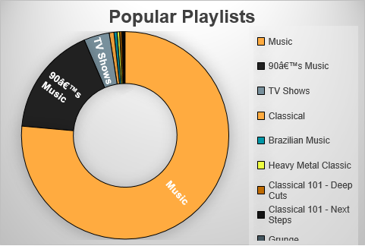
Question 1: Arrange the Playlists according to number of Tracks and the Total Spent from best to least
<visualization>
The general word “Music” wa the most popular name as a playlist and the second was 90’s music then TV shows coms third, then other names come next by far according to number of sales

Slide 2
Question 2: Arrange the Artists according to number of Tracks and the Total Sales from most sales to least
Iron Maiden was the most popular artist by far from the next one which is U2 then Metallica and Led Zeppelin was near to U2.

Slide 3
Question 3: Arrange the Employees according to number of Customers and the Total Sales from most sales to least
Jane Peacock is the best sales rep according to number of customer and sales and Margaret Park comes next then Steve Johnson was the third and last one.

Slide 4
Question 4: Arrange the Albums according to number of Tracks and the Total Sales from most sales to least
According to sales figures “Greatest Hits” was the best seller album with 26 track and sales more than 350 and “Lost, Season 2” came next with half number of tracks and near to 300 sales then “Heroes, Season 1” , “Lost, Season 1” and “Lost, Season 3” came next.

